Slide 1
Analysis of the Rationality of Usage of Physical Server Resources
Faculty of Computer Science
Big Data and Information Retrieval School
Moscow 2023
Type: Software Project
Kind: Group Project
Author: Daria Andreevna Lapko, DSBA 201
Supervisor: Dmitry Yurievich Frolov, Senior System Analysist, JSC “NSPK”

Slide 2
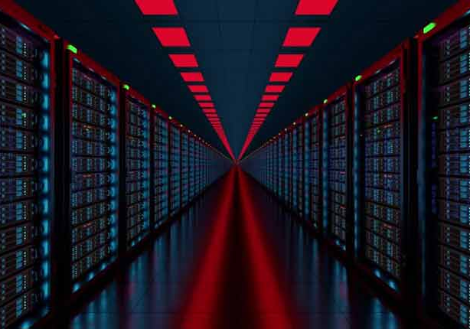
Subject Area Reminder: Server Load Analysis
Big Data and Information Retrieval School
Analysis of the Rationality of Usage of Physical Server Resources
Nowadays, big IT and related companies own thousands of servers for different tasks. And as company grows, the number of servers increases too.
However, with each server it becomes more and more costly to install and maintain it in working condition. Hence, it is crucial to use servers rationally and efficiently to be profitable.
The goal of our group project is to create a tool for “NSPK” JSC to analyze how rationally the servers are used.
Source: https://fknet.ir/brand/fknet/?per_row=3&shop_view=grid&min_price=1900000&max_price=2850000

Slide 3
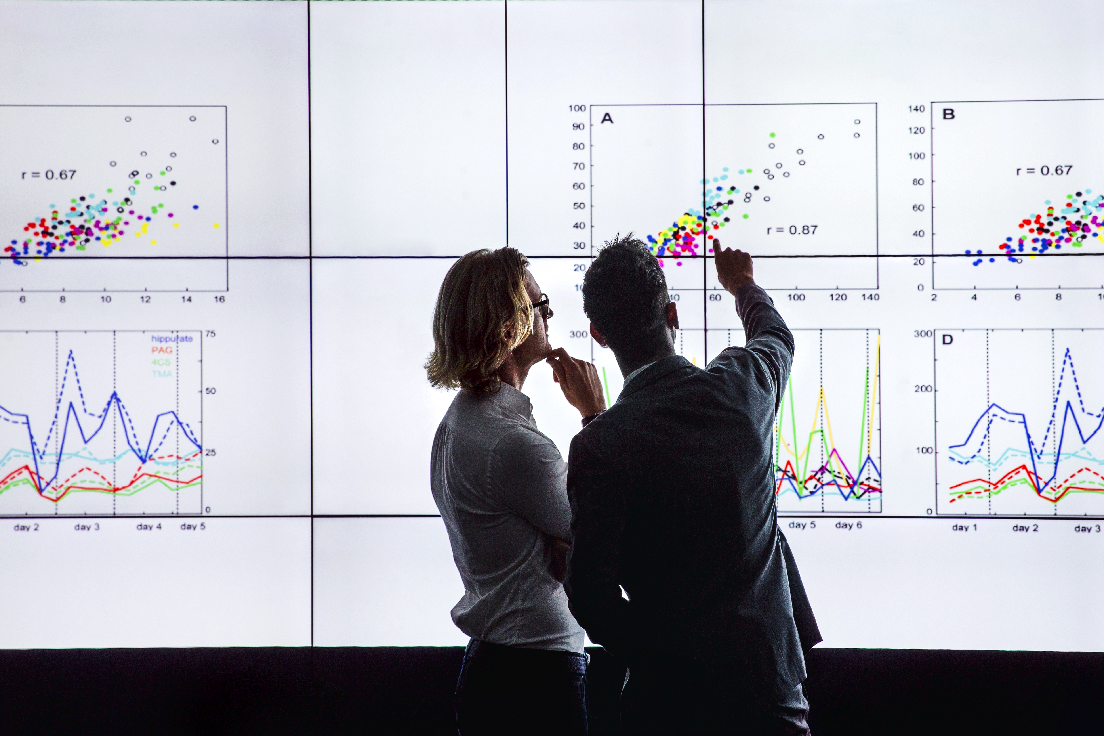
The Relevance of Work
Big Data and Information Retrieval School
Analysis of the Rationality of Usage of Physical Server Resources
The general project aim is about finding shortcomings in the current usage of servers in the company. The data, which is obtained and prepared by my groupmates, contains valuable information about server productivity, but it is difficult to make decisions by looking at a table with figures.
The analysis of obtained data is done much easier when it is presented visually. By making different charts, we can look on the same data from different sides and make plenty of conclusions.
The data must look presentable, since it is very likely that a business-related person from the company with no IT background will take a look and assess the situation based on presented visualizations.
Source: https://uk.kuehne-nagel.com/en/-/knowledge/argos-tableau-implementation-journey

Slide 4

Purpose and Tasks
Big Data and Information Retrieval School
Analysis of the Rationality of Usage of Physical Server Resources
The purpose of my part of the project is to create visualizations to analyze obtained data about server load and share it with the company specialists.
This purpose includes several tasks:
Make prototype of application with future dashboards, where each dashboard includes several related charts.
Prepare data for visualizing.
Make application with dashboards, which describes data about server load.
Source: https://elearningindustry.com/10-online-research-tools-every-online-learner-know

Slide 5
Functional Requirements & Non-Functional Requirements
Big Data and Information Retrieval School
Analysis of the Rationality of Usage of Physical Server Resources
Among all the requirements, dedicated to our team, I show ones related to my work.
Functional:
The application is expected to aggregate the data from different teams across the company and its subdivisions to present an overall picture of server usage.
The application is expected to visualise the historical data of server usage and aggregate metrics.
The application is expected to cluster the company’s servers according to determined usage patterns.
Non-Functional:
The visualisations provided by the application are expected to be interactive.
The application is expected to satisfy the corporate standard of availability for business-critical systems.
The application is expected to be horizontally scalable.
The application is expected to be universally employable given similar infrastructure (availability of similar data collection, storage, processing and visualisation tools).

Slide 6
The Choice of Instruments
Big Data and Information Retrieval School
Analysis of the Rationality of Usage of Physical Server Resources
Figma – a powerful cloud-based design platform. Vector networks, frames, and components are just a few of the design capabilities and tools offered by Figma. Prototypes can also have interactivity and animations added to them.
Tableau – a modern Data Analytics and Business Intelligence platform. It allows users to create interactive and dynamic visualisations, dashboards, and reports with real-time analytics and quick responsiveness from various data sources. It provides easy access to insights and helps businesses make data-driven decisions.
Kibana – a tool for data exploration and visualisation. It offers a simple user interface for developing and disseminating interactive dashboards, graphs, and charts based on Elasticsearch data. It also has machine learning capabilities, saved searches, visualisations, and other features that make it an effective tool for data analysis and discovery.

Slide 7
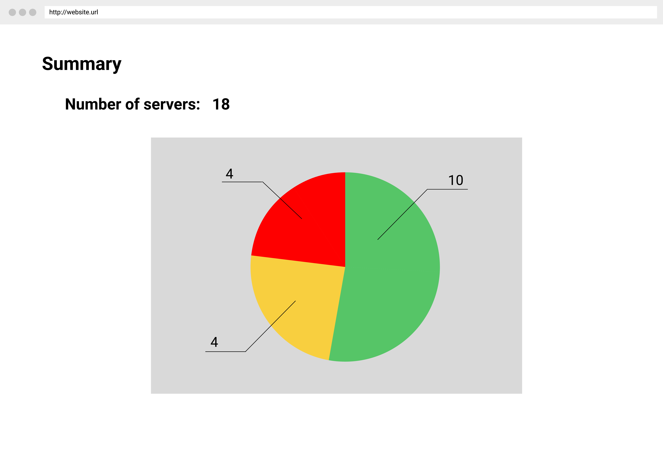
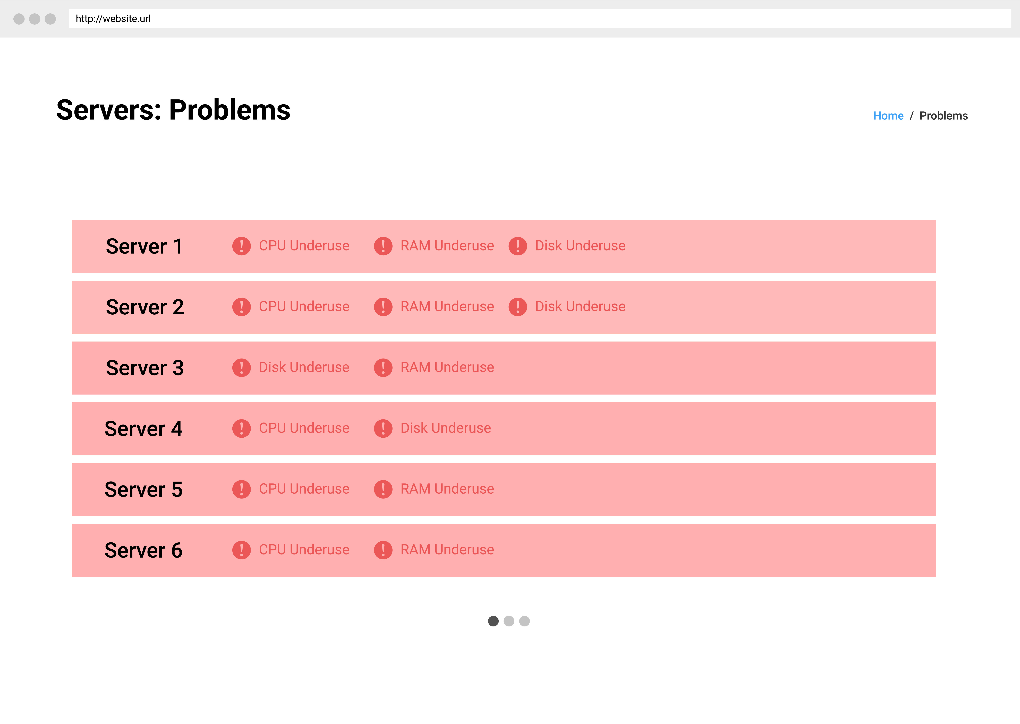
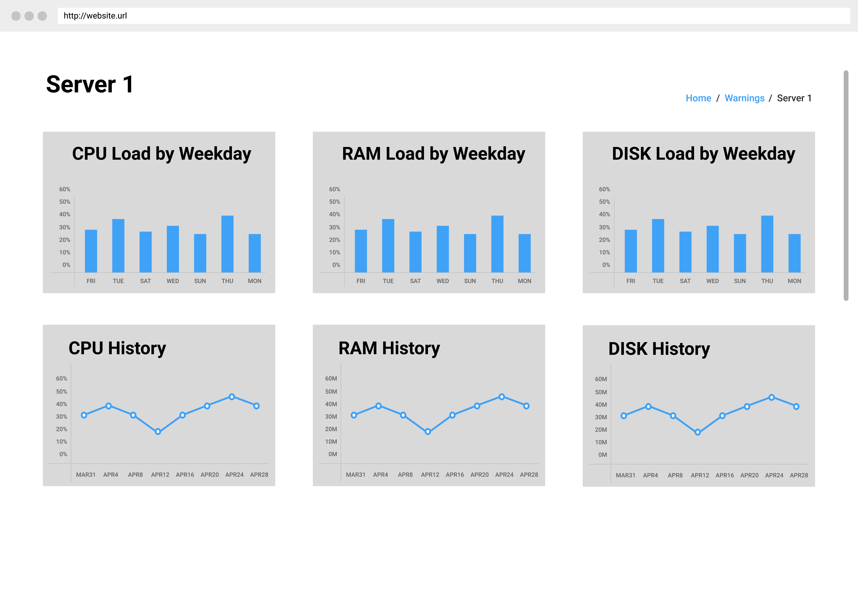
Implementation: Step 1 – Making the Prototype
Big Data and Information Retrieval School
Analysis of the Rationality of Usage of Physical Server Resources
The prototype was created in Figma web application.
It is important to create a prototype because it allows to plan future look of application, which will show charts with real data.
Prototype looks like a website, which is what it was expected to look like initially.
At the start, I prepared different version of the prototype, but after getting feedback from the project supervisor, I improved it and added crucial graphs and features. Now you can see the final version of it.
The prototype is interactive (it is possible to click on some objects and move between pages).
Three pages of the prototype: main page (top), page with list of problematic servers (middle) and page with statistics of one server (bottom).
Source: my screenshot

Slide 8
Implementation: Step 2 – Preparing the Data
Big Data and Information Retrieval School
Analysis of the Rationality of Usage of Physical Server Resources
The data, which come to me from my groupmates, is not completely ready to be visualized.
In order to prepare the data, I do:
Change the date offset into UTC date.
Remove useless columns.
Rename columns which have ambiguous name.
All mentioned work is done through code. The instruments are Python language, pandas and datetime libraries.
Source: https://www.sibros.tech/post/platform-abstraction-creating-portable-code-across-projects

Slide 9
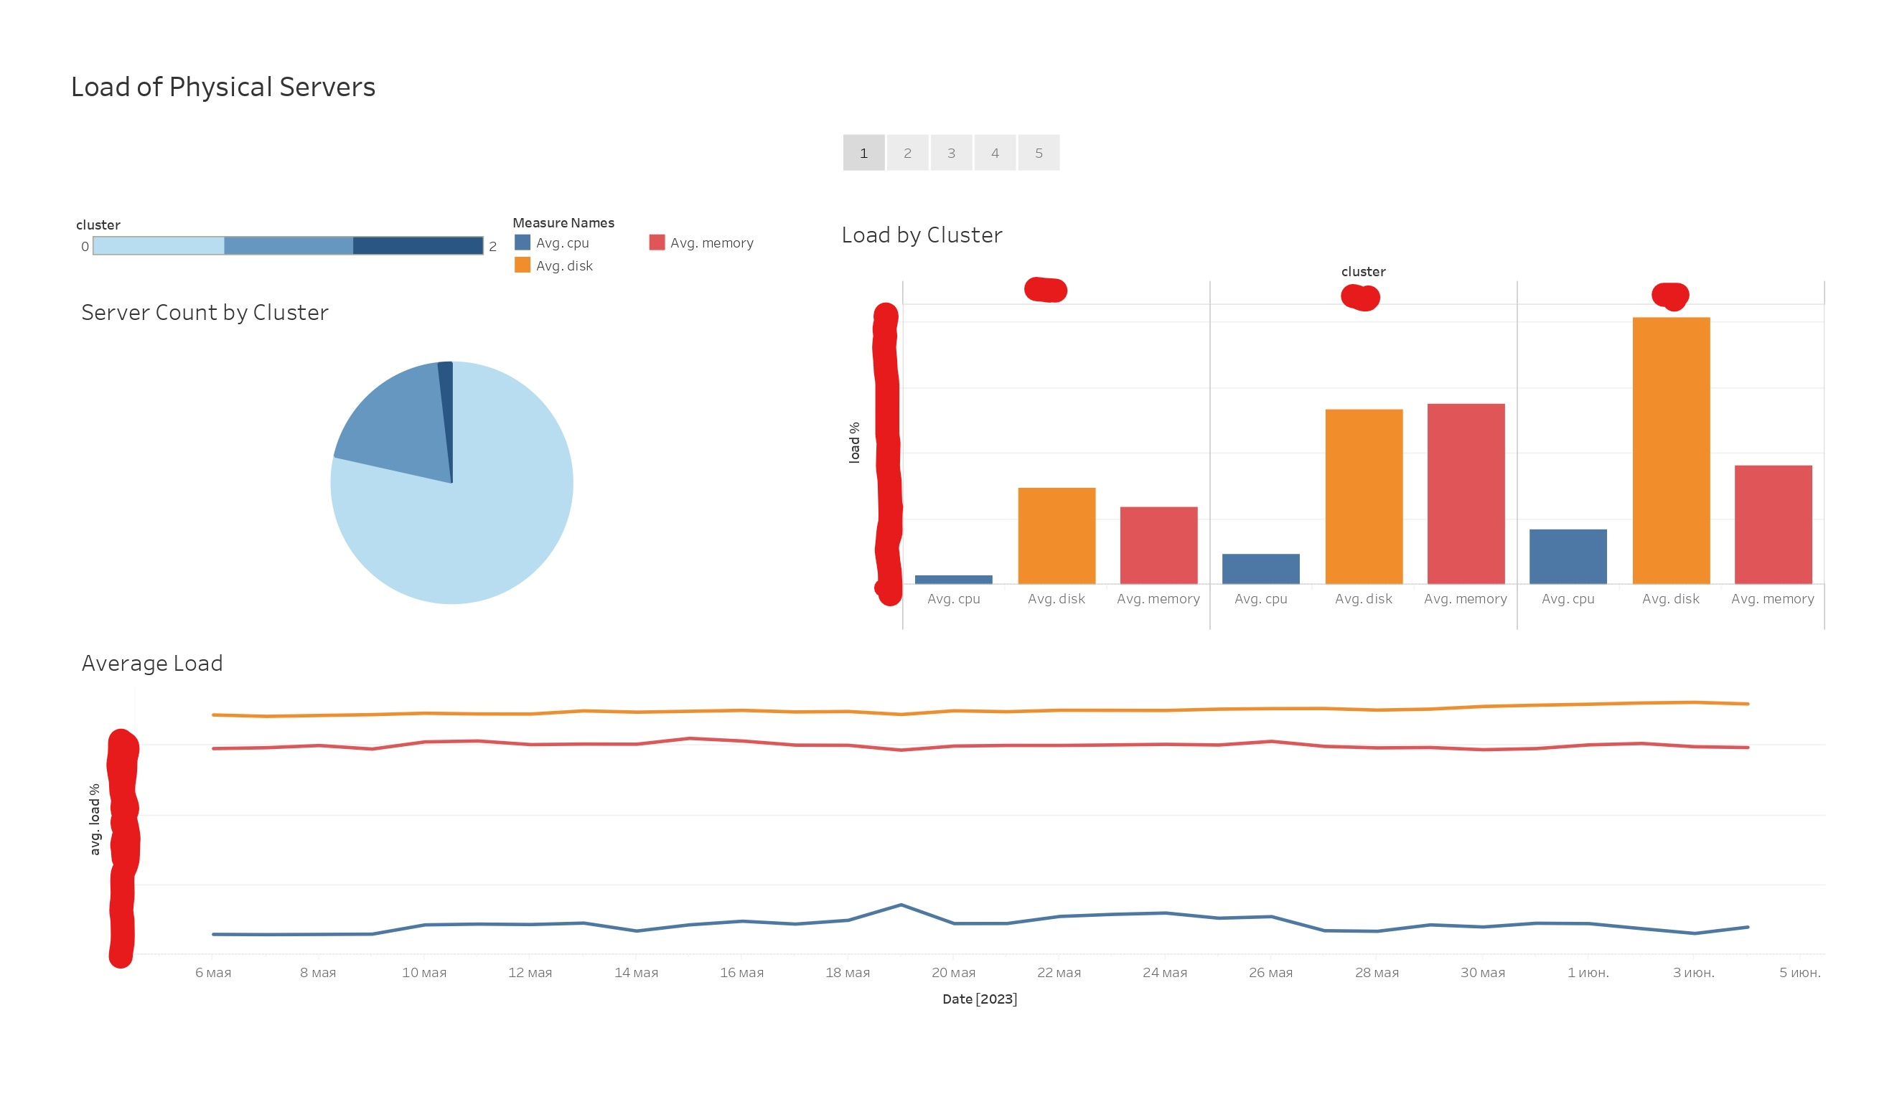
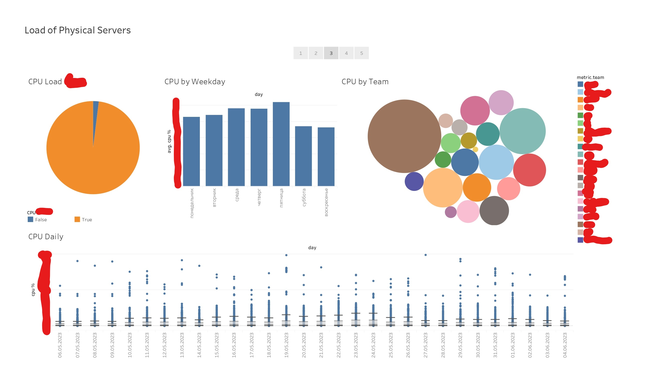
Implementation: Step 3 – Creating the Dashboards
Big Data and Information Retrieval School
Analysis of the Rationality of Usage of Physical Server Resources
Due to issues with access to the corporate data, I was not able to work in Kibana and make web application.
I switched to Tableau instead, where I made a story – series of 5 dashboards.
Each dashboard contains few charts, which are combined by the type of information they convey.
The difference in charts allows to look on the same data from different sides and make various conclusions about server load.
Many charts were based on Figma prototype, while additional ones were also added by the means of extended Tableau functionality.
Two dashboards illustrating their general look.
Source: my screenshot

Slide 10
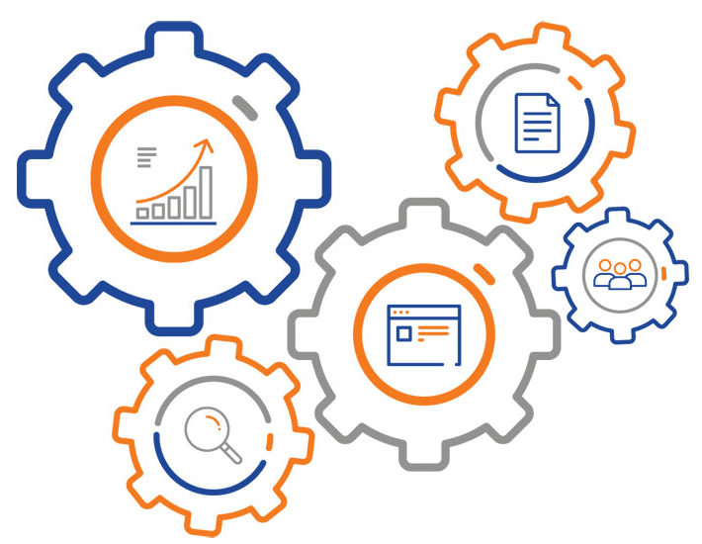
Implementation: Additional Step – Automating the Data Transmission
Big Data and Information Retrieval School
Analysis of the Rationality of Usage of Physical Server Resources
Additional to initial tasks, I was able to bind Tableau and the Jupyter notebook, where the data preparation is done.
The data is now transmitted dynamically and updated, without the need to save and load files manually.
The charts in Tableau adapt to the new data as soon as it is changed in the notebook.
Important for future automation of the whole process in the company.
All mentioned work is done through code, in the same file with data preparation. The instruments are Python language, jupytab and jupytab-server libraries, and some other configuration files.
Source: https://www.kindpng.com/imgv/hohxbib_process-automation-regression-testing-icon-hd-png-download/

Slide 11
Main Results and Conclusions
Big Data and Information Retrieval School
Analysis of the Rationality of Usage of Physical Server Resources
The initially stated goal was achieved completely, although by different means than initially planned.
An additional feature was implemented: automatic transmission of data.
It showed good results in dynamically transmitting the data and updating charts inside Tableau.
Practically significant work: the company requires visualizations to be a part of the project to make decisions.
Performed creative and analytical work, while building and assessing the constructed charts.
New knowledge about previously unencountered instruments and Python libraries: Kibana, Figma, jupytab, etc.
Additional practice of Python code writing, exploring libraries’ documentation, using Windows to configure server connection.
Experience of working in a big IT-related company and its team of professionals: from DevOps engineers to system and business analysts.

Slide 12
Directions for Further Work
Big Data and Information Retrieval School
Analysis of the Rationality of Usage of Physical Server Resources
The number of dashboards certainly can be extended to 15-20 to convey more valuable information and be clearer.
Other types of charts can be added.
Additional features can be compared to those already done.
Some charts may be changed, where they look ambiguous and present reduced amount of information. They may be exchanged into something more obvious and indicative.
After sharing the dashboards with the IT department leaders, I may obtain even more recommendations and ideas for improvement.
After the issue with privacy in Kibana will be solved on the company’s side, it may be more effective to move back to this app since it is more familiar to IT department employees and intended tool for this rather than Tableau.

Slide 13
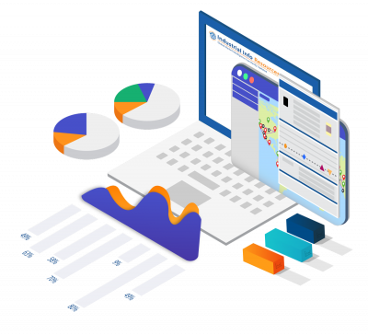
Thank you for your attention! I am ready to answer your questions!
Big Data and Information Retrieval School
Analysis of the Rationality of Usage of Physical Server Resources
Source: https://www.kserv.ru/catalog/bitriks24/uslugi_po_vnedreniyu_sistem_avtomatizatsii/yunikraft/378223/

